Slide 1
E-Commerce Customer Segmentation and Prediction
Presented by: Abhishek Kumar
Institute: Boston Institute of Analytics

Slide 2
Agenda
Introduction:
Dataset Overview:
Data Cleaning Process:
Exploratory Data Analysis (EDA):
RFM Model Overview:
RFM Calculation:
Predictive Modelling
Conclusion:

Slide 3
Introduction
In the fast-growing e-commerce industry, understanding customer behaviour is crucial for business success. Companies need to identify high-value customers, predict purchasing trends, and optimize marketing strategies to maximize revenue.
This project focuses on Customer Segmentation and Prediction using machine learning techniques to categorize customers based on their purchasing patterns.
We use clustering models (K-Means, Hierarchical Clustering, DBSCAN) to segment customers and Logistic Regression to predict high-value customers.
The insights from this project will enable e-commerce businesses to personalize marketing campaigns, improve customer engagement, and enhance profitability.
Key Objectives: ✔ Identify different customer segments based on transaction history. ✔ Predict high-value customers for better marketing strategies. ✔ Improve business decision-making using data-driven insights.

Slide 4
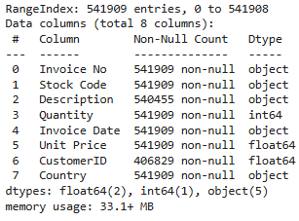
Understanding the Data
Dataset Overview:
The dataset consists of transaction-level data collected from a retail store.
There are 541,909 rows and 8 columns containing details about purchases made by customers.
Data Source:
The data is stored in a CSV file (data.csv), with columns like invoice numbers, Stock codes, descriptions, quantities, customer IDs, and more.

Slide 5
Key columns
Invoice No: A unique identifier assigned to each invoice, representing a transaction or order.
Stock Code: A unique product code assigned to items sold, enabling product identification and tracking.
Description: Provides details about the product, aiding in understanding its nature and purpose.
Quantity: Specifies the number of items purchased or returned in a transaction. Negative values indicate returns.
Invoice Date: Records the exact date and time when a transaction occurred, useful for time-based analysis.
Unit Price: Represents the price per unit of a product in the transaction. Used to calculate sales revenue.
Customer ID: A unique identifier for each customer, useful for tracking buying behavior and segmentation.
Country: Indicates the geographical location of the customer, helping in regional sales analysis

Slide 6
Data Cleaning and Preprocessing
Handling Missing Values:
The dataset had missing values in the Description column (0.27%) and CustomerID column (24.93%).
Rows with missing values were removed, reducing the dataset from 541,909 rows to 406,829 rows.
Data Type Conversion:
The Customer ID column was converted from a float type to a string for better processing and to maintain consistency.
Country Analysis:
The Country column reveals the geographical distribution of orders.
The majority of orders (88.95%) originate from the United Kingdom. Other notable contributors include Germany, France, and EIRE.
Data for countries with smaller contributions like Lithuania and Brazil are also captured for completeness.

Slide 7
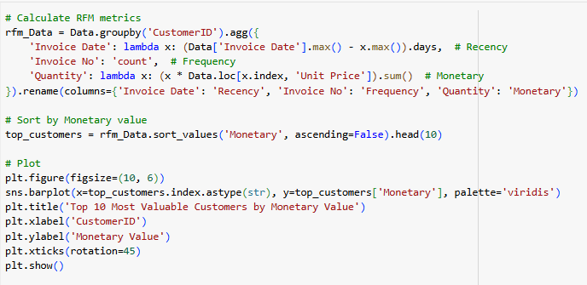
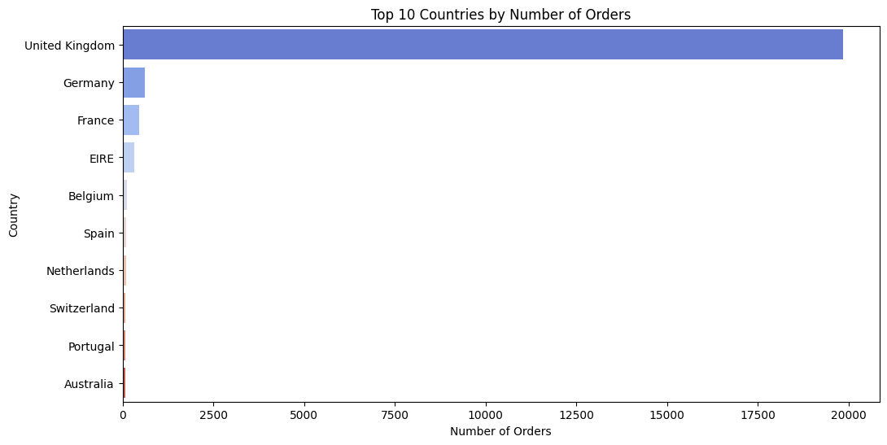
Visualization of Top 10 Countries by Orders:
A bar chart was plotted to showcase the top 10 countries by their percentage of total orders.
The United Kingdom dominates, followed by Germany, France, and EIRE.
It helps identify the most active markets and potential regions for business expansion.
Key Insights:
The high concentration of orders in the United Kingdom highlights a domestic market focus.
Smaller percentages from other countries provide opportunities for market expansion.

Slide 8
RFM Analysis for Customer Segmentation
RFM Analysis
Recency, Frequency, Monetary(Amount) - (RFM) Analysis
RFM Metrics:
Recency: Days since the customer’s last purchase.
Frequency: Number of purchases by the customer.
Monetary: Total amount spent by the customer.
Objective: Identify and segment customers for personalized marketing and engagement.

Slide 9
Monetary Value(Amount) -
The total amount spent by a customer.
it helps identify high-value customers based on spending.
Multiply the Quantity and UnitPrice for each transaction.
Aggregate the spending for each CustomerID.
Frequency -
The number of transactions a customer made during the timeframe.
High-frequency customers indicate loyalty and engagement.
Count the unique invoices for each CustomerID.

Slide 10
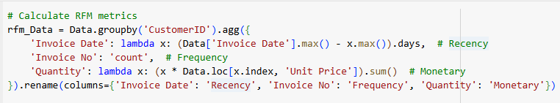
Recency -
The number of days since a customer’s last transaction.
Recent purchases suggest higher likelihood of repeat purchases.
Calculate the difference between max_date (last transaction date in the dataset) and each customer's Invoice Date.
Extract the number of days for comparison.

Slide 11
📊 Technical Analysis of RFM Chart
Data Processing Excellence
Code smartly aggregates customer behaviour into RFM metrics.
Uses sophisticated groupby operations to condense 541,909 transactions
Custom lambda functions capture complex purchasing patterns
Clean visualization using seaborn's barplot with veridic colour palette

Slide 12
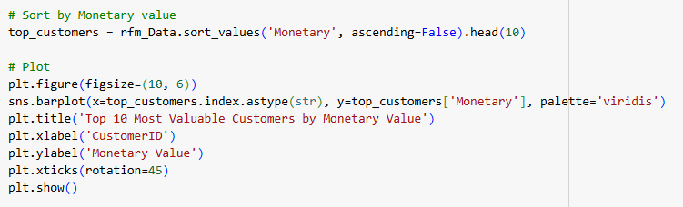
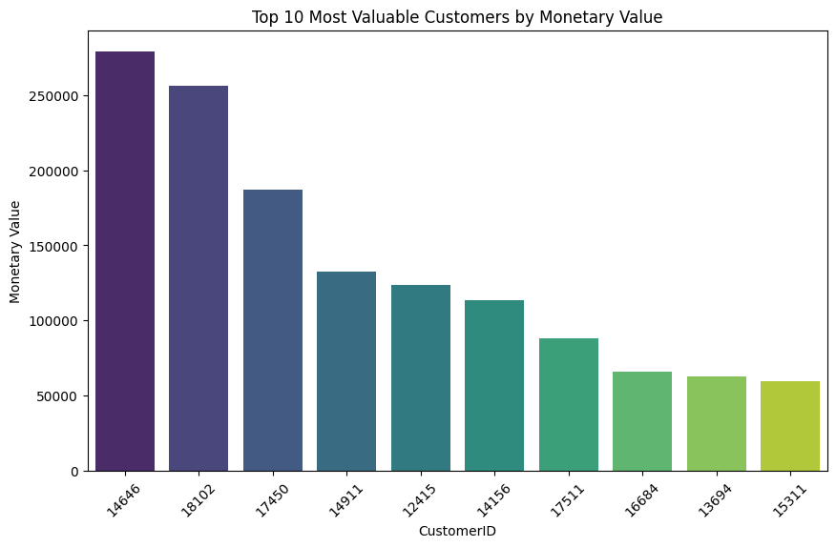
10 Most Valuable Customers.
Key Revenue Contributors:
Top 3 customers account for a significant share of revenue.
Special retention strategies should be applied to them.
Revenue Distribution is Uneven:
A large part of the business depends on a few customers.
Need to diversify customer base and increase spending among other customers.
Actionable Strategies:
Personalization, loyalty programs, upselling, and win-back campaigns.
It helps identify high-value customers who contribute the most to the business's revenue.

Slide 13
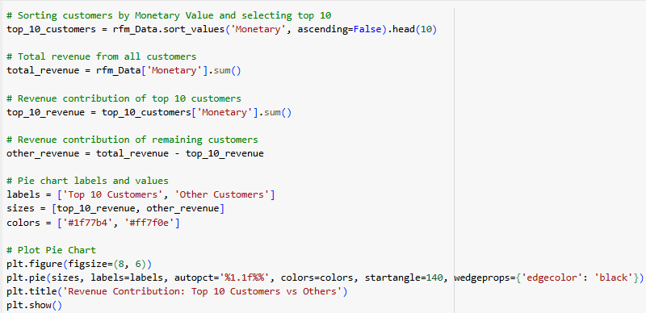
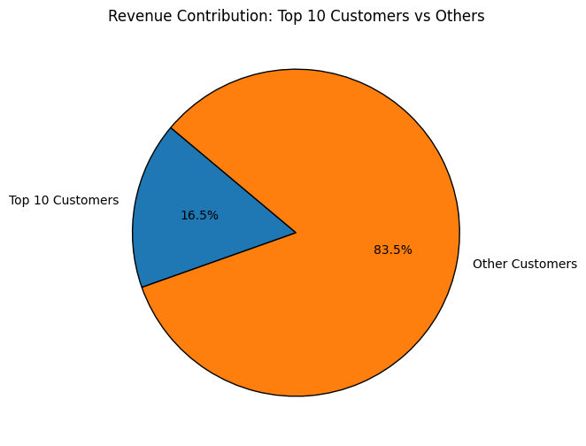
Revenue Contribution: Top 10 vs. Others
Revenue Distribution Analysis
Core Revenue Breakdown
Top 10 Customers: 16.5% of total revenue.
Other Customers: 83.5% of total revenue.
Clear visualization of revenue concentration.
Business Health Indicators
Healthy revenue diversification.
Not overly dependent on top customers.
Strong broad customer base.
Strategic Implications
16.5% revenue from just 10 customers shows efficient key account management.
83.5% from broader base indicates strong market presence
Shows potential for growing more customers into top tier

Slide 14
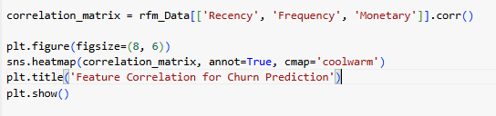
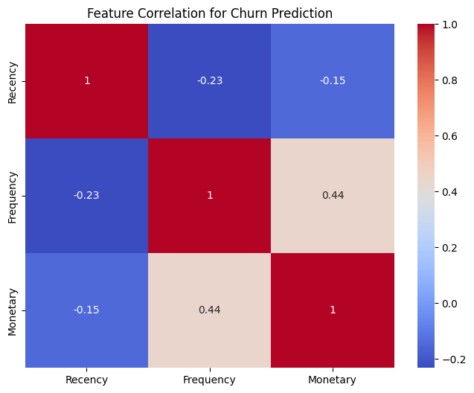
Customer Churn Prediction (Feature Correlation)
Recency Relationships
Strong negative correlation (-0.23) with Frequency
Customers who bought recently tend to buy more often
Recent buyers are more engaged
Negative correlation (-0.15) with Monetary value Recent customers don't necessarily spend the most
High spenders may not always be recent buyers
Frequency Insights
Moderate positive correlation (0.44) with Monetary value
More frequent buyers tend to spend more
Shows loyal customers are more valuable
Key Patterns
Frequency & Monetary show strongest positive link (0.44)
Focus on increasing purchase frequency
Could lead to higher customer spending
Business Implications
Focus on increasing purchase frequency
Don't assume recent customers are biggest spenders
Regular buyers are likely to be more valuable

Slide 15
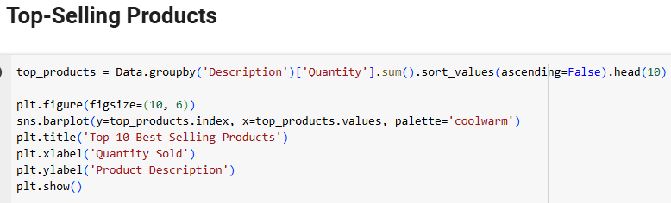
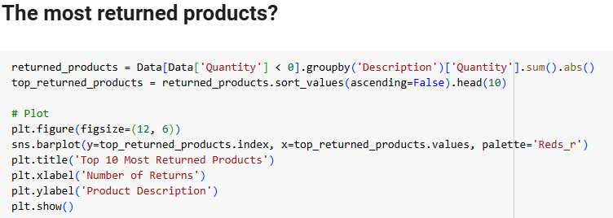
📊 Product Performance Analysis
Top Sellers Success Story
🥇 WORLD WAR 2 GLIDERS leads sales (~40,000 units)
🥈 JUMBO BAG RED RETROSPOT close second (~38,000 units)
🥉 RETROSPOT CAKE CASES strong third (~30,000 units)
Home decor & party supplies dominate top sellers
Returns Pattern Analysis
Highest Returns:
PAPER CRAFT, LITTLE BIRDIE (~80,000 returns)
CERAMIC TOP STORAGE JAR (~75,000 returns)
Dramatic drop after top 2 returned items
3.Category Performance
Strong Sellers:
Decorative items
Party supplies
Storage solutions
Problem Areas:
Craft supplies
Ceramic products
Paper products

Slide 16
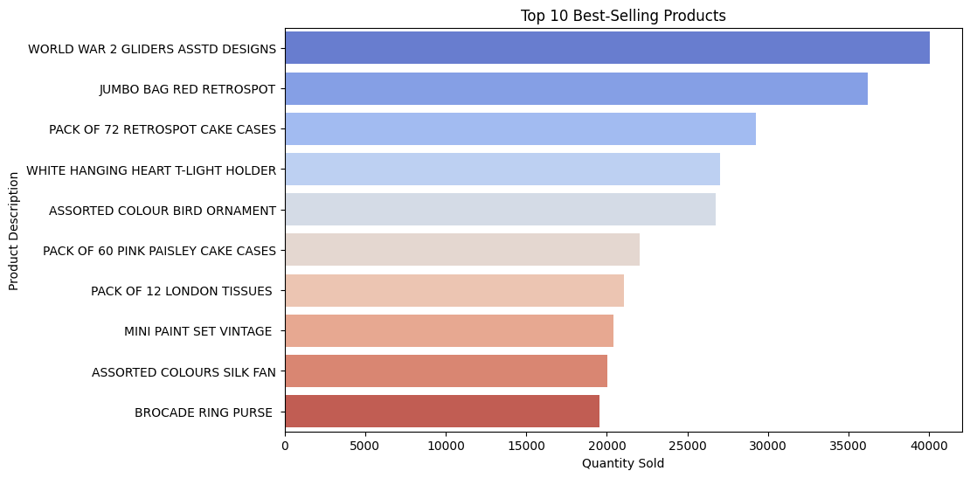
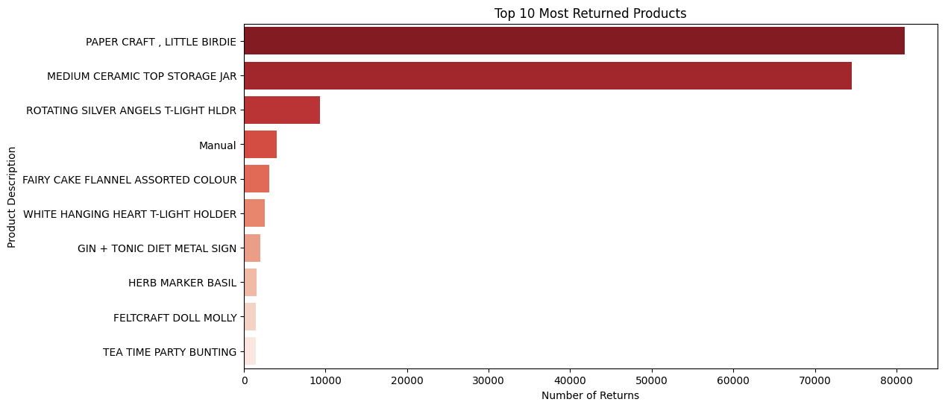
Action Recommendations
🔍 Investigate high return rates for craft items
💡 Review product descriptions for top returned items
🛠️ Quality control focus on ceramic products
📦 Evaluate packaging for fragile items
📝 Update product descriptions to manage expectations

Slide 17
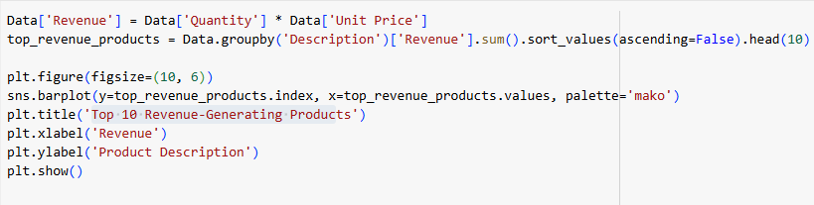
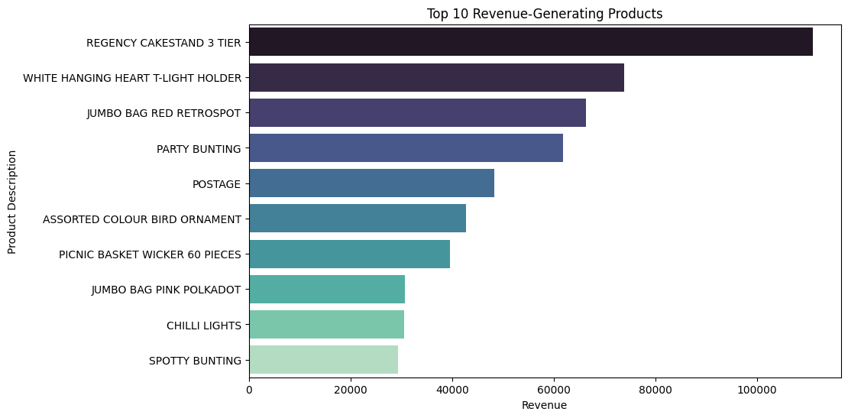
Top 10 Revenue-Generating Products
Top Performance Breakdown
🥇 REGENCY CAKESTAND 3 TIER (~100K revenue)
Clear revenue leader
Premium product positioning
Significant revenue gap from second place
🥈 WHITE HANGING HEART T-LIGHT HOLDER (~80K revenue)
Strong second position
Consistent high performer
Popular decorative item
🥉 JUMBO BAG RED RETROSPOT (~70K revenue)
Solid third place
Storage solution category strength
2.Revenue Distribution
Top 3 products generate ~250K combined
Even distribution among lower 7 positions
Clear revenue tiers visible:
Premium (80K-100K): 2 products
Mid-tier (40K-70K): 4 products
Base tier (20K-40K): 4 products
3.Action Recommendations
Increase stock of top 3 revenue generators
Create premium product bundles
Develop marketing around event planning
Expand successful product categories

Slide 18
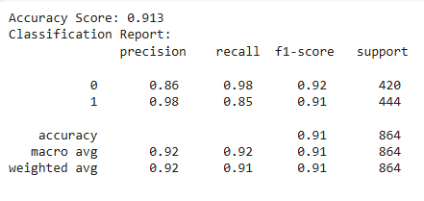
📊 Logistic Regression Performance Analysis
Overall Model Excellence
Outstanding Accuracy: 91.3%
Strong overall performance across metrics
Balanced predictions across classes
Large sample size: 864 data points
Class-wise Performance Class 0 (420 samples):
Precision: 0.86 (86% accurate predictions)
Recall: 0.98 (98% of actual cases identified)
F1-Score: 0.92 (strong balance of precision & recall)
Class 1 (444 samples):
Precision: 0.98 (98% accurate predictions)
Recall: 0.85 (85% of actual cases identified)
F1-Score: 0.91 (excellent balance)
3.Key Business Implications
Highly reliable predictions (91.3% accuracy)
Low false positive rate
Balanced performance across classes
Suitable for business decision-making

Slide 19
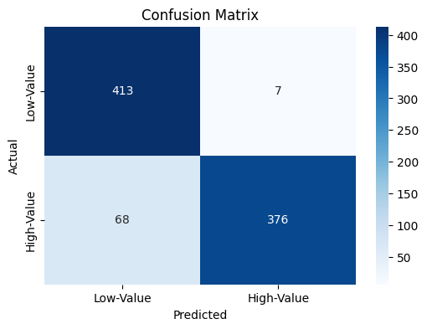
📊 Confusion Matrix Analysis
Overall Performance Breakdown
True Positives (High-Value): 376 customers
True Negatives (Low-Value): 413 customers
False Positives: 7 customers
False Negatives: 68 customers
Total Predictions: 864 customers
Key Success Metrics
High Accuracy in Low-Value Prediction:
413 correct out of 420 (98.3% accurate)
Only 7 misclassifications
Strong High-Value Detection:
376 correct out of 444 (84.7% accurate)
Higher value proposition identified well
Areas of Attention
False Negatives: 68 cases
Missed high-value customer opportunities
Potential revenue impact
Action Recommendations
Focus on reducing 68 false negatives
Investigate characteristics of misclassified customers
Regular model retraining with new data

Slide 20
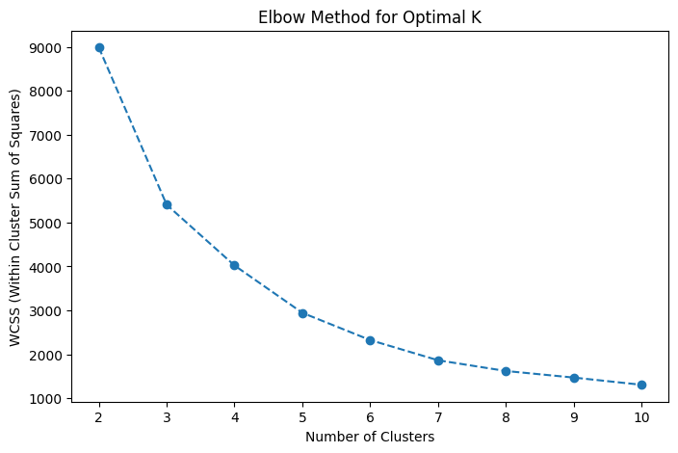
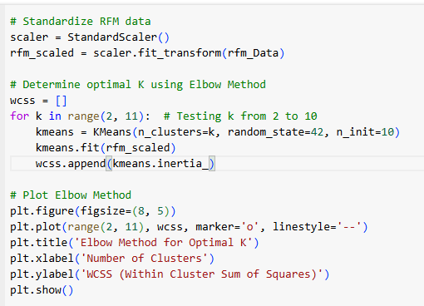
Determining the Optimal Number of Clusters - Elbow Method
Elbow Curve: Used to determine the optimal number of clusters by plotting the Sum of Squared Distances (SSD) for different values of k.
The "elbow" of the curve shows the optimal number of clusters.

Slide 21
K-Means Clustering
Introduction to K-Means Clustering
K-Means is an unsupervised machine learning algorithm used for customer segmentation.
It groups customers into K clusters based on similar characteristics (Recency, Frequency, and Monetary Value).
Why Use K-Means for Customer Segmentation?
Helps identify high-value customers for targeted marketing. Improves customer retention strategies. Enhances personalized promotions and product recommendations. Optimizes business decision-making with data-driven insights.

Slide 22
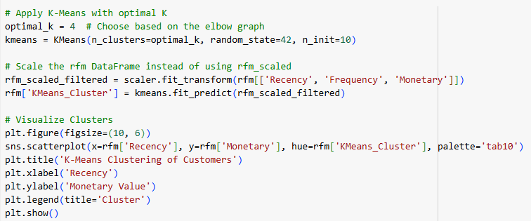
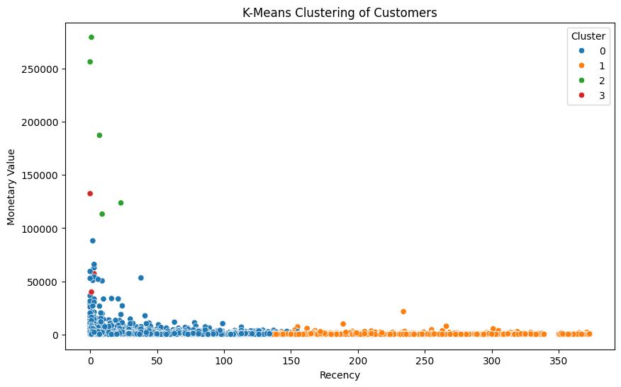
Key Findings from K-Means Clustering Chart
📌 Cluster 0 (Blue) – Loyal & frequent buyers with high spending. 📌 Cluster 1 (Orange) – Inactive customers who haven’t purchased recently. 📌 Cluster 2 (Green) – VIP customers with extremely high monetary value. 📌 Cluster 3 (Red) – Medium-value customers who still engage but less frequently.
Business Impact & Insights
📈 Personalized Marketing – Offer tailored discounts based on customer clusters. 📈 Customer Retention – Re-engage inactive customers with special offers. 📈 Revenue Growth – Focus on high-value segments for higher profitability.

Slide 23
Hierarchical Clustering
Introduction to Hierarchical Clustering
Hierarchical Clustering is an unsupervised learning technique that groups customers based on similarity.
It creates a tree-like structure (Dendrogram) to show how data points (customers) are related.
Why Use Hierarchical Clustering?
No need to pre-define the number of clusters.
Provides a clear visual representation (Dendrogram) of customer relationships.
Helps in customer segmentation for targeted marketing.
Useful for analysing customer behaviour patterns over time.

Slide 24
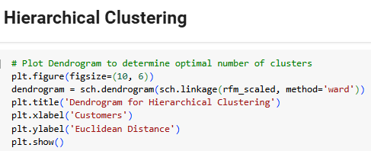
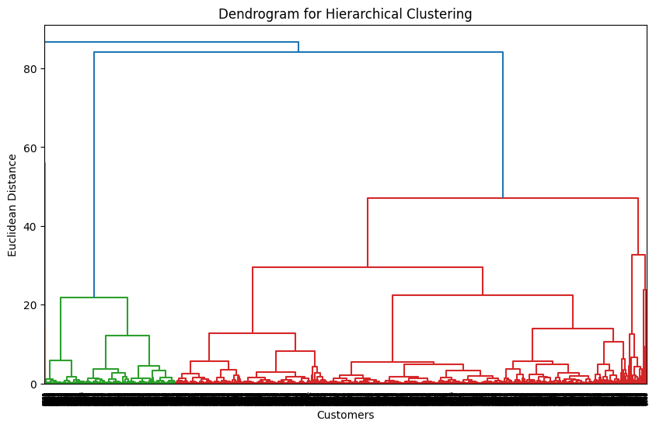
Hierarchical Clustering Dendrogram
Large Cluster Formation (Top-Level Split)
The highest Euclidean Distance split indicates two major customer segments.
One segment includes high-value customers, and the other consists of low-value or inactive customers.
Sub-Clusters at Lower Distances
Smaller clusters represent similar customer behaviour, like frequent buyers or dormant users.
The green cluster represents tightly grouped high-value customers.
The red cluster shows customers with varying spending behaviours.

Slide 25
DBSCAN (Density-Based Spatial Clustering of Applications with Noise)
Introduction to DBSCAN
DBSCAN (Density-Based Clustering) is an unsupervised learning algorithm used for customer segmentation based on data density.
Unlike K-Means and Hierarchical Clustering, DBSCAN can identify outliers and detect arbitrarily shaped clusters.
Why Use DBSCAN?
No need to pre-define the number of clusters (Unlike K-Means).
Handles noise (outliers) effectively, making it useful for customer segmentation.
Finds clusters of varying shapes and densities, unlike K-Means, which assumes spherical clusters.
Works well when data has high variance or overlapping clusters.
How DBSCAN Works?
Uses two parameters: 📌 Epsilon (ε) – Defines the radius around a point to consider as a neighbour. 📌 MinPts – Minimum number of points required to form a cluster.

Slide 26
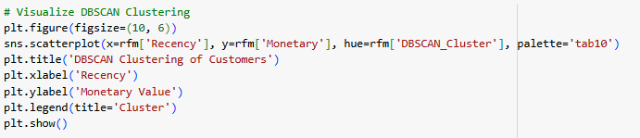
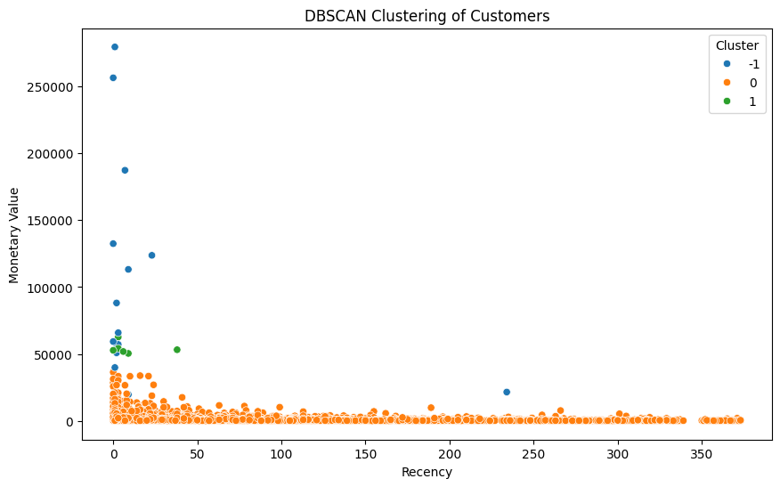
Cluster Distribution Analysis:
Cluster -1 (Blue): Noise/Outliers
High-value customers (>100K)
Scattered purchase patterns
Unique buying behaviours
Requires individual attention
Cluster 0 (Orange): Dense Core
Majority of customers
Lower monetary values
Consistent purchase patterns
Regular customer base
Cluster 1 (Green): Secondary Group
Mid-range monetary values
Recent purchasers
Distinct from main cluster
Growth potential segment

Slide 27
Conclusion:
By implementing RFM segmentation, we successfully identified distinct customer groups based on their purchasing behavior. Through careful outlier detection and segmentation, we were able to deliver actionable insights that can drive more targeted and efficient marketing strategies. This analysis not only helps in understanding customer loyalty and value but also enables businesses to focus resources on high-value segments, enhancing overall customer retention and profitability.
What We Did:
RFM Segmentation: Applied Recency, Frequency, and Monetary (RFM) analysis to segment customers based on their purchasing behavior.
Outlier Detection: Identified outliers in the data to ensure the quality of the segmentation.
Customer Segmentation: Grouped customers into meaningful segments to understand behavior patterns.
Data Visualization: Visualized the customer segments for better insights and decision-making.

Slide 28
What We Got: Customer Segments: Defined customer groups with unique spending behaviors, highlighting high-value and loyal customers. Outlier Identification: Cleaned the dataset by addressing extreme values, improving model accuracy.

